Slide 1
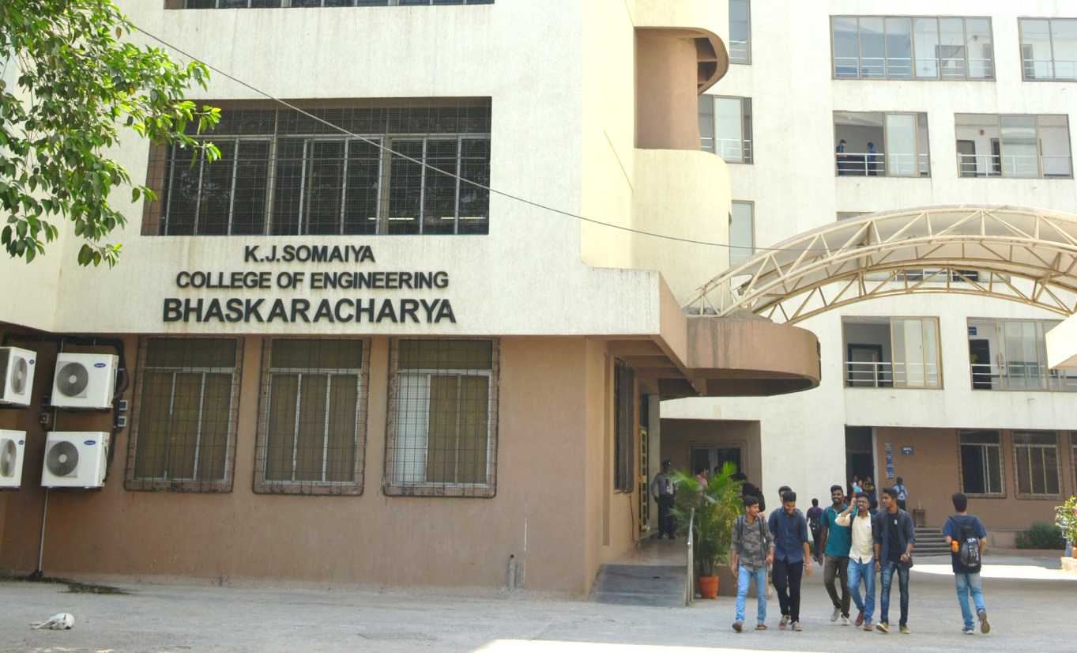
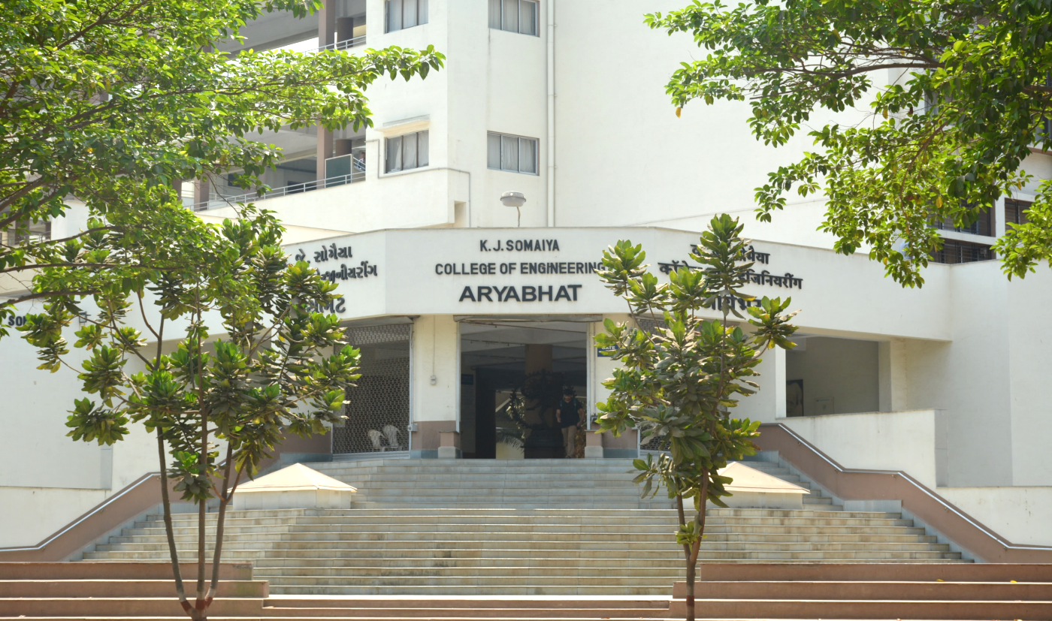
Automated Description Generation for Jewellery Images using Deep Learning
Department of Information Technology

Slide 2
Automated Description Generation for Jewellery Images using Deep Learning
Group ID: 4
Group Members:
Tanisha Mangaonkar - 16010422200
Prachi Gandhi - 16010422233
Chandana Galgali - 16010422234
Mahek Thakkar - 16010422235
Guide Details:
Name - Avani Sakhapara
Department - Information Technology

Slide 3
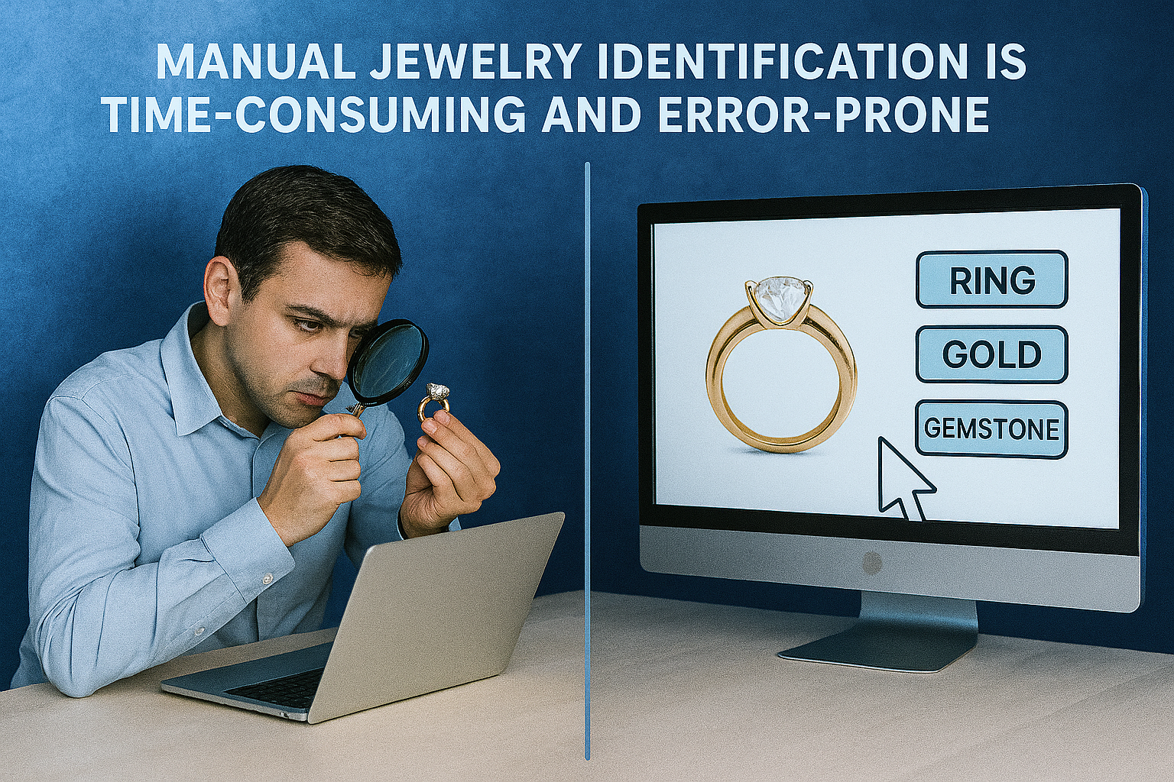
Need for the project
Manual jewellery identification is time-consuming and error-prone.
Existing systems only offer basic object detection without detailed understanding like metal colour, gemstone, etc.
Difficulties in maintaining accurate, searchable digital catalogs.

Slide 4
Problem Definition
Develop an automated system that detects necklaces and earrings from a person’s image, generates captions describing their metal colour, gemstones and classifies them based on presence of gemstones, metal colour, etc.

Slide 5
Background Work / Literature Survey
Jewellery Detection and Identification
General Object Detection and Tracking
Gemstone and Material Classification
Image Captioning

Slide 6
Background Work / Literature Survey
Jewellery Detection and Identification
Year | What is the paper about? (Aspects) | Methodology (Steps in 2-3 lines) | Datasets (Size, Type, etc.) | Results (Validation Metrics) | Advantages | Limitations | Reference No.
2024 | Uses image captioning for jewellery classification in e-commerce. | Used VGG-16 and MobileNet as CNN encoders, GRU and LSTM as RNN decoders to generate multi-level jewellery captions, followed by classification using parsed caption attributes. | Created a comprehensive jewellery image database from local jewellery stores. | Achieved high accuracy using VGG-16 + GRU with strong F1-scores. | Accurate and robust jewellery detection with end-to-end automated recognition, handling diverse styles and occlusions effectively. | Performance drops on similar-looking items like bracelets, relies on high-quality labeled datasets, and is limited to predefined jewellery categories. | [1]
2023 | Applies CNNs and Faster R-CNN for accurate image/video detection. | Used Faster R-CNN with a CNN backbone to extract features from Yakshagana images, applied region proposal networks (RPN) to locate small jewel regions, followed by ROI pooling and classification layers for precise jewel detection. | No detailed dataset info given; tested on public jewellery item datasets (implied). | Achieved high mAP and precision using Faster R-CNN for small jewel detection. | Faster R-CNN offers high precision, excels at detecting small jewellery items in complex images, and leverages deep learning adaptability for reliability. | Computationally intensive, needs large datasets, and is limited to Yakshagana-specific images. | [2]
2021 | Automates jewellery tagging via transfer learning and live feeds. | Created an image repository of jewellery, labeled images by category, trained a transfer learning model, and used OpenCV for real-time classification via live camera feed. | Used a manually created image repository of jewellery articles for training and validation. | Achieved accurate, real-time jewellery recognition with strong validation metrics. | Automates real-time jewellery tagging and classification using transfer learning, reducing manual errors, manpower, and enabling accurate live camera-based recognition. | Requires a large, well-labeled image repository, with performance heavily influenced by image quality and lighting, and may struggle with unseen jewellery types without retraining. | [3]

Slide 7
Background Work / Literature Survey
Jewellery Detection and Identification
Year | What is the paper about? (Aspects) | Methodology (Steps in 2-3 lines) | Datasets (Size, Type, etc.) | Results (Validation Metrics) | Advantages | Limitations | Reference No.
2025 | Proposes neural network for automatic jewellery description generation. | Used computer vision and various image captioning architectures, especially encoder-decoder models, trained on a comprehensive jewellery image database. | Built a large jewellery image dataset to train image captioning models. | Achieved high captioning accuracy with detailed descriptions of diverse jewellery. | Assists non-experts with detailed jewellery insights, generating accurate, hierarchical captions across varied styles. | Depends on image database quality, struggles with rare designs, and requires intensive training for captioning models. | [4]
2024 | Develops vision method to track gold necklaces for theft prevention. | Improved traditional Gaussian Mixture Model (GMM) with adaptive background subtraction (ABS) for enhanced detection and tracking of gold necklaces. | Used video/image sequences from gold shops for detection and tracking evaluation. | Achieved high frame tracking accuracy, outperforming the standard GMM method. | Tracks small, deformable objects effectively with ABS-enhanced accuracy, aiding theft prevention in gold shops. | Limited to shop settings, sensitive to occlusion and fast movement, and reliant on lighting and camera quality. | [5]
2023 | Presents mobile-friendly FC-YOLOv4 for fashion item detection. | Developed and compared a custom FC-YOLOv4 model with YOLOv3 and YOLOv4 using a dataset of 13,689 images across 10 categories, evaluated on mobile devices. | Dataset of 13,689 images covering five fashion and five accessories categories. | Achieved high mAP and IoU with reduced size and mobile efficiency. | Achieves extremely high accuracy (99.84% mAP), optimized for low-RAM mobile devices, and ensures faster detection for efficient e-commerce product categorization. | Limited to predefined categories, needs large labeled datasets, and performance varies across smartphone hardware. | [6]

Slide 8
Background Work / Literature Survey
Jewellery Detection and Identification
Year | What is the paper about? (Aspects) | Methodology (Steps in 2-3 lines) | Datasets (Size, Type, etc.) | Results (Validation Metrics) | Advantages | Limitations | Reference No.
2023 | Proposes jewellery retrieval using local HSV color histograms. | Extracted feature vectors from five local regions in HSV space, applied a classification module, and matched similarity scores for jewellery retrieval. | Used publicly available jewellery item retrieval datasets: ringFIR and Fashion Product Images. | Outperformed baselines on ringFIR and Fashion datasets in retrieval accuracy. | Effective in handling occlusion and shape deformation Lightweight and color-focused feature extraction Performs well on real-world jewellery datasets | Limited to HSV color space features May struggle with grayscale or low-color-contrast images Less robust compared to deep learning-based retrieval methods | [7]

Slide 9
Background Work / Literature Survey
General Object Detection and Tracking
Year | What is the paper about? (Aspects) | Methodology (Steps in 2-3 lines) | Datasets (Size, Type, etc.) | Results (Validation Metrics) | Advantages | Limitations | Reference No.
2023 | Compares YOLOv5–v7; YOLOv6 excels. | Created a custom jewellery dataset, applied data augmentation, and trained multiple YOLO versions to compare their small object detection performance. | Used a custom dataset of jewellery images captured from a jewellery store with data augmentation. | YOLOv6 outperformed YOLOv5/YOLOv7 in accuracy, F1, recall, and mAP. | Targets small object detection using a real-world jewellery dataset, comparing multiple YOLO versions and highlighting YOLOv6’s superior performance. | Dataset covers only three jewellery classes, limiting generalization, and lacks full exploration of real-time deployment challenges. | [8]
2023 | Proposes CNN-YOLOv7 for jewellery in smart stores. | Uses a CNN-based YOLOv7 model trained on a custom jewellery dataset for accurate detection and localization of small jewellery objects in smart store surveillance. | Used a unique dataset curated specifically for smart store surveillance focused on jewellery. | Achieved strong metrics on custom data using YOLOv7 for lightweight surveillance. | Designed for detecting small, intricate objects in surveillance, this lightweight model delivers high accuracy and real-time efficiency on custom jewellery datasets. | Primarily focused on jewellery, limiting generalization; may struggle in cluttered or low-light settings and needs a specialized dataset for training. | [9]
2022 | Reviews YOLO/CNN for real-time detection. | Surveyed and analyzed YOLO algorithm versions and CNN architectures for real-time object detection and feature extraction. | No original dataset; it’s a review of YOLO and CNN models applied in literature. | Reported higher mAP and FPS, showing YOLO's real-time detection advantage. | Offers high accuracy and real-time speed with efficient CNN-based detection, enabling broad industrial applicability. | May underperform on small or overlapping objects, needs significant computational resources, and relies on high-quality training data. | [10]

Slide 10
Background Work / Literature Survey
General Object Detection and Tracking
Year | What is the paper about? (Aspects) | Methodology (Steps in 2-3 lines) | Datasets (Size, Type, etc.) | Results (Validation Metrics) | Advantages | Limitations | Reference No.
2023 | Proposes YOLO-based system for ring and earring detection in smart shops. | Trained and validated a YOLO-based object detector on a custom dataset of rings and earrings for real-time monitoring in smart shop surveillance systems. | Used a customized dataset containing rings and earrings images. | Achieved real-time, accurate detection with strong mAP and localization metrics. | Enables real-time jewellery monitoring in smart shops with high accuracy using a lightweight, efficient YOLO architecture. | Limited to only two jewellery classes (rings and earrings) May require retraining for different store layouts or lighting conditions | [11]
2021 | Surveys DL models, datasets, and edge suitability. | Reviewed and compared deep learning-based object detection models using benchmark datasets, evaluation metrics, and backbone architectures, including lightweight models for edge deployment. | No specific dataset used; it’s a survey paper reviewing existing models and benchmarks. | Compared detectors using mAP, FPS, and parameters for accuracy and efficiency. | Covers modern object detection models, benchmark datasets, and metrics, with insights on lightweight models and performance comparisons. | Lacks original experiments, relies solely on literature analysis, and may miss post-2021 advancements. | [12]
2023 | Compares CNN and transformer models for object detection. | Conducted a comparative analysis of CNN and transformer architectures for object detection, focusing on design, performance, and attention mechanisms. | Literature review; no dataset used. | Provided literature-based insights without experimental metrics or validation. | Provides a thorough overview of CNN and transformer-based detectors, highlighting the shift to attention models and outlining emerging research trends. | Purely literature-based without experimental validation, lacks quantitative benchmarks, and may miss the latest transformer model developments. | [13]

Slide 11
Background Work / Literature Survey
Gemstone and Material Classification
Year | What is the paper about? (Aspects) | Methodology (Steps in 2-3 lines) | Datasets (Size, Type, etc.) | Results (Validation Metrics) | Advantages | Limitations | Reference No.
2023 | Proposes CNN-RF model for gemstone ID using curated images. | Used CNN for feature extraction from gemstone images and integrated a Random Forest classifier for final classification, trained on a 6265-image dataset with a 70:30 split. | Dataset of 6,265 gemstone images with 70:30 train-test split. | Achieved strong classification accuracy for effective gemstone identification. | Combines strengths of deep learning and traditional ML Works well on a moderate-sized dataset Applicable to geological and mineralogical domains | Accuracy (~74.76%) leaves room for improvement Performance may degrade on unseen gemstone types Limited dataset diversity may affect generalization | [14]
2024 | Uses CNN-LSTM with LIBS to classify jewellery rocks. | Applied CNN layers for feature extraction from LIBS data and LSTM layers for sequence modeling, with interpretability analysis and Lasso feature selection. | Used laser-induced breakdown spectroscopy (LIBS) data from different jewellery rock samples. | Achieved high accuracy in classifying jewellery rocks using deep learning and LIBS. | Combines spectroscopy with interpretable deep learning High accuracy in classifying diverse jewellery rock types Provides layer-wise model interpretability | Requires specialized LIBS equipment May be limited to types of rocks studied Computationally intensive due to hybrid CNN-LSTM architecture | [15]

Slide 12
Background Work / Literature Survey
Image Captioning
Year | What is the paper about? (Aspects) | Methodology (Steps in 2-3 lines) | Datasets (Size, Type, etc.) | Results (Validation Metrics) | Advantages | Limitations | Reference No.
2023 | Explores how image captions enhance multimodal datasets for vision-language training. | Used synthetic captions from image captioning models and mixed them with raw web data, evaluating different strategies on a 128M image-text dataset. | Used large-scale web-scraped image-text datasets (128M and 1.28B pairs). | Outperformed prior filters on ImageNet, 38 tasks, Flickr, and MS-COCO. | Improves dataset quality without sacrificing diversity Boosts performance across multiple benchmarks Demonstrates scalable benefits on 1.28B image-text pairs | Synthetic captions may have limitations at very large scales Standard captioning benchmarks don’t predict real training utility Image curation becomes increasingly critical with dataset size | [16]

Slide 13
Outcomes of Background Work / Literature Survey
Manual jewellery identification is slow and error-prone.
Existing systems don’t provide detailed descriptions like metal colour, gemstone, etc.
Deep Learning models can automate detection and generate meaningful captions for jewellery.
AI can help preserve traditional jewellery by recognizing and describing cultural designs.
Most models focus only on detection and ignore semantic understanding.

Slide 14
Scope - Functional Requirements
Accept input image of necklace or earrings
Detect and identify necklaces and earrings in the image
Generate captions detailing metal colour and gemstones if present(based on the color)
Output structured descriptions and classifications for each detected item
Provide a user interface for image upload and result display

Slide 15
Scope - Non-Functional Requirements
Accuracy: The system must accurately detect and classify jewellery items with high precision. We achieved an accuracy of 94.91 % for jewellery detection (earring/necklace) from the uploaded image.
Response-time: The system processes images and deliver results promptly in about 1-2 seconds.
Usability: The interface should be simple and user-friendly for non-technical users like jewellers.

Slide 16

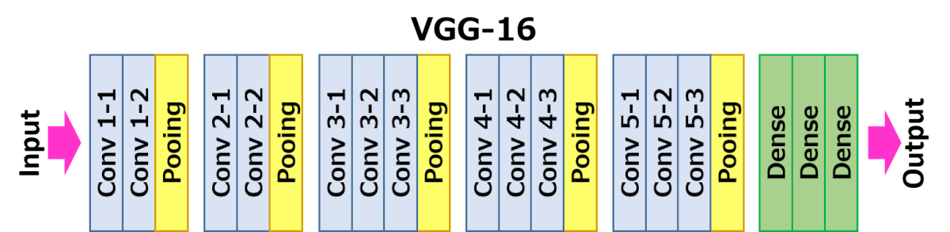
Technologies to be Used
Frontend UI
React framework for user interface
Detection & Classification, Feature Extraction, Image Captioning
Encoder : VGG-16
Decoder : GRU

Slide 17
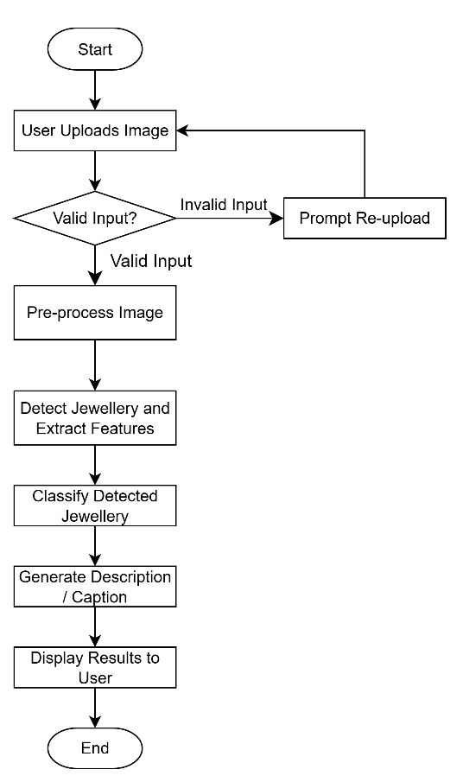
Overview Of Implementation
Flowchart showing the system workflow, beginning with an image uploaded by the user and moving through jewellery identification, type classification (such as necklace or earring), visual feature analysis, and automatic description generation, ending with result display and an optional retry step based on user feedback.

Slide 18
Overview Of Implementation
Detect Jewellery & Feature Extraction:
Encoder → VGG-16
PyTorch 2.0+ & Torchvision 0.15+ → Pretrained models to detect if uploaded image has earrings or necklace.
Extract features like Metal color, Gemstone presence.
Jewellery Classification & Caption Generation:
Decoder → Gated Recurrent Unit
Labels jewellery as earring or necklace.
Generates description of jewellery.
Sample Output: “A round necklace with emerald green gemstones set in yellow gold.”
Detect Jewellery & Feature Extraction
Jewellery Classification & Caption Generation

Slide 19
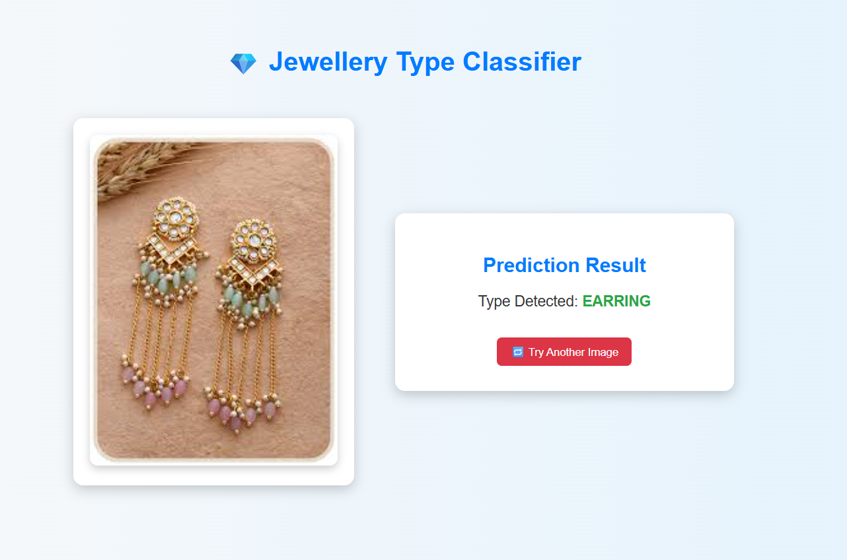
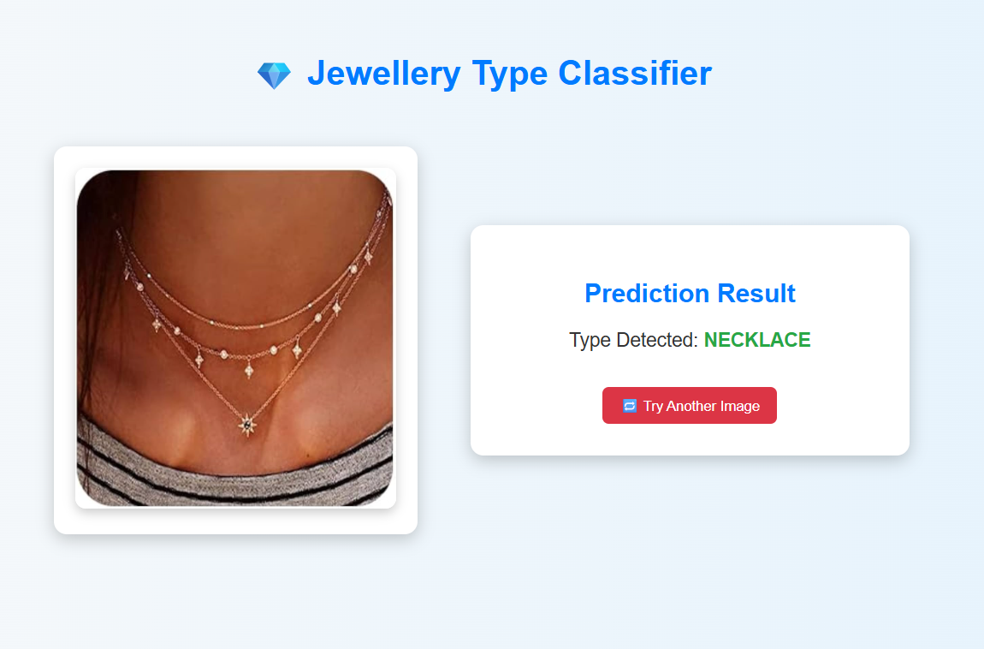
Frontend Implementation

Slide 20
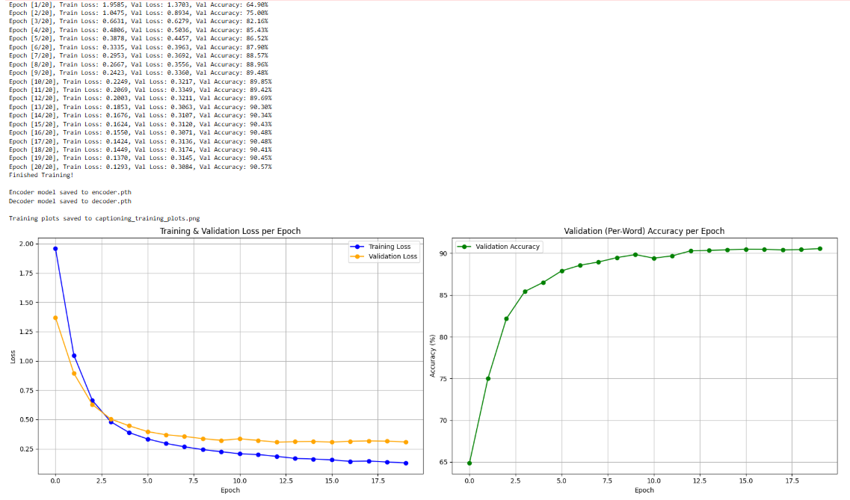
Backend Implementation

Slide 21
Dataset Details
Sources: The project combines two Hugging Face datasets:
Total dataset before augmentation: 5,021 images (5,000 from AI Tool Pool Jewelry Vision for classification + 21 necklace images with captions for captioning task)
Final Training Set: The sources were combined and augmented to create a final dataset of 32,442 images, consisting of 21,294 earrings and 11,148 necklaces.
Structure: The dataset is managed by a single image folder and a corresponding CSV file for all labels and metadata.
Data Split: It is programmatically split into an 80% training set and a 20% validation set.

Slide 22
Preprocessing Steps
Our project utilizes a two-stage preprocessing pipeline to ensure the data is robust and properly formatted for the model.
Stage 1: Preprocessing from the Source Dataset
The AI Tool Pool Jewelry Vision dataset from Hugging Face already had several transformations applied.
Basic Preprocessing:
Auto-orientation, Auto-contrast
Data Augmentation: Three augmented versions of each source image were created using the following techniques:
Flips, 90-degree Rotations, Random Rotation, Random Brightness

Slide 23
Preprocessing Steps
Stage 2: Preprocessing in Our Code
We apply the following torchvision.transforms pipeline to every image before training:
transforms.Resize((224, 224)): This resizes every image to a fixed resolution of 224x224 pixels. This is a mandatory step to match the required input dimensions of the VGG-16 neural network.
transforms.ToTensor(): This converts the image from a standard PIL format into a PyTorch FloatTensor.
transforms.Normalize(...): The tensor is then normalized channel-wise using the specific mean and standard deviation values from the ImageNet dataset. This is crucial because it ensures our input data has the same statistical properties as the data the VGG-16 model was originally pre-trained on.

Slide 24
Implementation Schedule
Task | Timeline
Problem Statement Refinement & Literature Review | July 14 – July 31
Dataset Collection & Curation | August 1 – August 15
Image Preprocessing | August 16 – August 31
Jewellery Detection and Classification Model Training | September 1 – September 30
Description Generation Model Training | October 1 – October 15
Frontend Integration | October 16 – October 31
Backend Integration & Testing | November 1 – November 20
Deployment on Vercel & Documentation | November 21 – December 5

Slide 25
References
S. S. A. Zaidi, M. S. Ansari, A. Aslam, N. Kanwal, M. Asghar, and B. Lee, “A Survey of Modern Deep Learning based Object Detection Models,” arXiv preprint, arXiv:2104.11892v2, May 2021.
M. Mafaz, “Identification of Jewellery Article using Transfer Learning and Image Repository,” International Journal of Advance Research, Ideas and Innovations in Technology (IJARIIT), vol. 7, no. 4, 2021.
V. Viswanatha, R. K. Chandana, and A. C. Ramachandra, “Real Time Object Detection System with YOLO and CNN Models: A Review,” Journal of Xi'an University of Architecture & Technology, vol. 12, no. 4, 2020.
L. Yang, “Investigation of You Only Look Once Networks for Vision-based Small Object Detection,” International Journal of Advanced Computer Science and Applications (IJACSA), vol. 14, no. 4, 2023.
W. Ni, “Implementation of a CNN-based Object Detection Approach for Smart Surveillance Applications,” IJACSA, vol. 14, no. 12, 2023.
A. Murthy, P. Devadiga, and N. P. S., “FASTER R-CNN Approach for Detecting Smaller Jewels in Yakshagana Image,” International Research Journal of Modernization in Engineering, Technology and Science (IRJMETS), vol. 5, no. 6, Jun. 2023.
W. Xu and Y. Zhai, “A YOLO-based Object Monitoring Approach for Smart Shops Surveillance System,” Journal of Optics, vol. 53, pp. 3163–3170, 2024.
Y. Thwe, N. Jongsawat, and A. Tungkasthan, “Accurate Fashion and Accessories Detection for Mobile Application based on Deep Learning,” International Journal of Electrical and Computer Engineering (IJECE), vol. 13, no. 4, pp. 4347–4356, Aug. 2023.
T. Nguyen, S. Oh, S. Y. Gadre, G. Ilharco, and L. Schmidt, “Improving Multimodal Datasets with Image Captioning,” in Proc. 37th Conf. Neural Information Processing Systems (NeurIPS), 2023.
S. Shah and J. Tembhurne, “Object detection using convolutional neural networks and transformer-based models: a review,” Journal of Electrical Systems and Information Technology, vol. 10, no. 1, 2023.
A. M. Shoib, S. Jabeen, C. Wang, and A. Tassawar, “Content-based Jewellery Item Retrieval using the Local Region-based Histograms,” arXiv preprint, arXiv:2305.07540v1, May 2023.
Yashu, V. Kukreja, K. Madan, A. Singh, and D. Kumar, “GemID: A Hybrid CNN-Random Forest Approach for Accurate Gemstone Identification,” in Proc. 3rd Int. Conf. Smart Generation Computing, Communication and Networking (SMART GENCON), Dec. 2023, pp. 1–6.
J. M. Alcalde-Llergo, E. Yeguas-Bolívar, and A. Fuerte-Jurado, “Jewellery Recognition via Encoder-Decoder Models,” arXiv preprint, arXiv:2401.08003v1, Jan. 2024.
A. Thanakrirkphon and S. Mruetusatorn, “Detection and Tracking Shape-Shifting Gold Necklaces Using Computer Vision Techniques,” in Proc. IEEE Conf., 2023.
P. Khalilian et al., “Jewellery rock discrimination as interpretable data using laser-induced breakdown spectroscopy and a convolutional LSTM deep learning algorithm,” Scientific Reports, vol. 14, Art. no. 5169, 2024.
J. M. Alcalde-Llergo et al., “Automatic Identification and Description of Jewellery Through Computer Vision and Neural Networks for Translators and Interpreters,” Applied Sciences, vol. 15, no. 10, Art. no. 5538, 2025.

